Slide 1
CSCI 431/631 Foundations of Computer Vision
Ifeoma Nwogu
ion@cs.rit.edu
Lecture – Convolutional neural networks

Slide 2
Schedule
Last class
Neural networks
Today
Convolutional neural networks I
Readings for today:
Online deep learning tutorial from Stanford
http://cs231n.github.io/convolutional-networks/

Slide 3
Deep learning
Learn a feature hierarchy all the way from pixels to classifier
Each layer extracts features from the output of previous layer
Train all layers jointly (backpropagation)
Image/ Video
Pixels
Layer 1
Layer 2
Layer 3
Simple Classifier
Notes:
Make clear that classic methods, e.g. convnets are purely supervised.

Slide 4

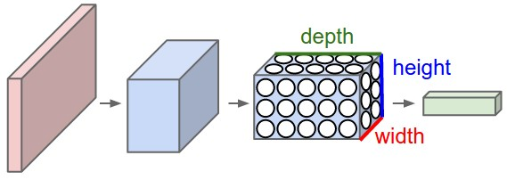
CNN
A ConvNet arranges its neurons in three dimensions (width, height, depth),
as visualized in one of the layers. Every layer of a ConvNet transforms the 3D input volume to a 3D output volume of neuron activations.

Slide 5
CNN Steps
INPUT [32x32x3] will hold the raw pixel values of the image, in this case an image of width 32, height 32, and with three color channels R,G,B.
CONV layer will compute the output of neurons that are connected to local regions in the input, each computing a dot product between their weights and a small region they are connected to in the input volume. This may result in volume such as [32x32x12] if we decided to use 12 filters.

Slide 6
CNN Steps cont’d
RELU layer will apply an elementwise activation function, such as the max(0,x)max(0,x) thresholding at zero. This leaves the size of the volume unchanged ([32x32x12]).
POOL layer will perform a downsampling operation along the spatial dimensions (width, height), resulting in volume such as [16x16x12].

Slide 7
CNN Steps cont’d
FC (i.e. fully-connected) layer will compute the class scores, resulting in volume of size [1x1x10], where each of the 10 numbers correspond to a class score, such as among the 10 categories of CIFAR-10. As with ordinary Neural Networks and as the name implies, each neuron in this layer will be connected to all the numbers in the previous volume.

Slide 8
Neural networks for images
feature map
weight mask
image
convolutional layer

Slide 9
Neural networks for images
image
convolutional layer

Slide 10


Pooling
Input volume of size [224x224x64] is pooled with filter size 2,
stride 2 into output volume of size [112x112x64].

Slide 11
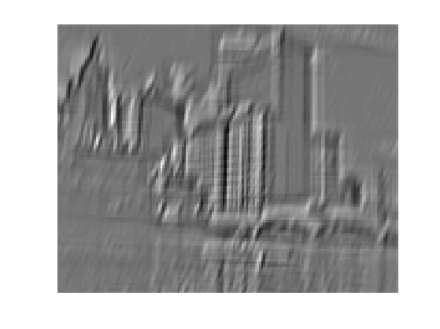
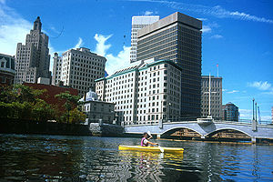
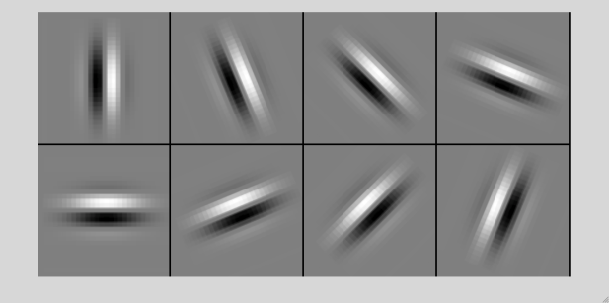
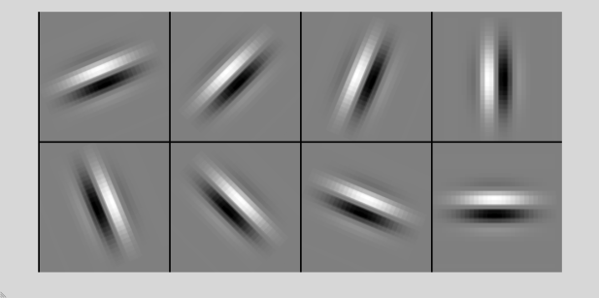
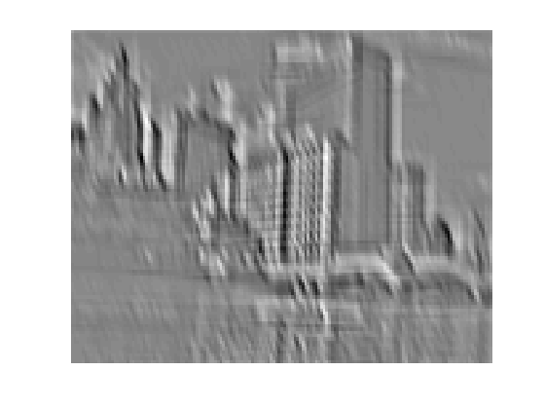
Convolution as feature extraction
...
Input
Feature Map

Slide 12
Convolutional Neural Networks
Feature maps
Normalization
Spatial pooling
Non-linearity
Convolution (Learned)
Input Image

Slide 13
Convolutional Neural Networks
Feature maps
Normalization
Spatial pooling
Non-linearity
...
Convolution (Learned)
Input
Input Image
Feature Map

Slide 14
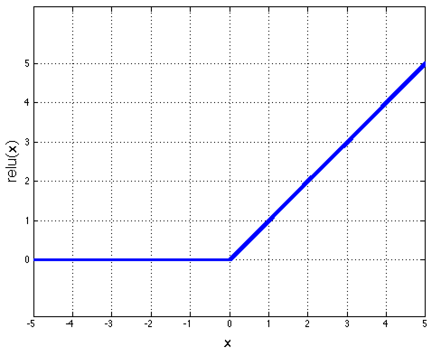
Convolutional Neural Networks
Feature maps
Normalization
Spatial pooling
Non-linearity
Convolution (Learned)
Input Image

Slide 15
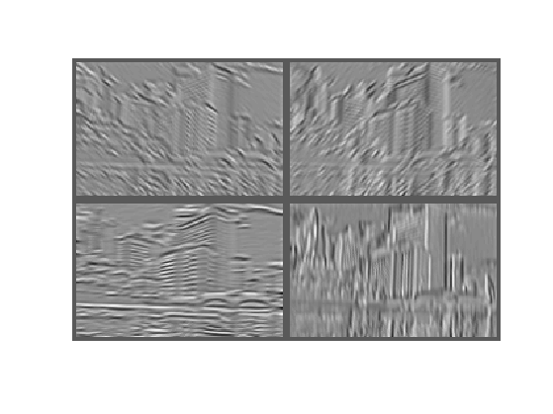
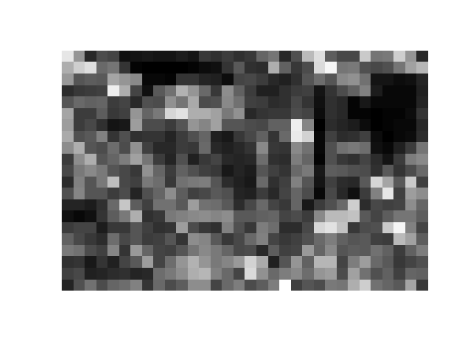
Convolutional Neural Networks
Feature maps
Normalization
Max
Spatial pooling
Non-linearity
Convolution (Learned)
Input Image

Slide 16
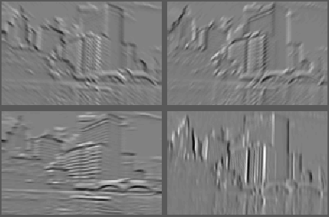
Convolutional Neural Networks
Feature maps
Normalization
Spatial pooling
Feature Maps
Feature Maps After Contrast Normalization
Non-linearity
Convolution (Learned)
Input Image

Slide 17
Convolutional Neural Networks
Feature maps
Normalization
Convolutional filters are trained in a supervised manner by back-propagating classification error
Spatial pooling
Non-linearity
Convolution (Learned)
Input Image

Slide 18

Summary: CNN
for Image Classification
Many slides from Rob Fergus, Andrej Karpathy

Slide 19

Simplified architecture
Softmax layer:

Slide 20
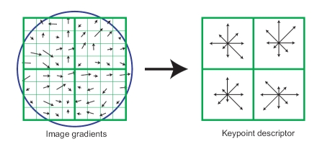
Compare: SIFT Descriptor
Lowe [IJCV 2004]
Image Pixels
Apply oriented filters
Take max filter response (L-inf normalization)
Feature Vector
Spatial pool (Sum), L2 normalization
Notes:
Note pooling is across space, not across Gabor channel
Normalization is really nonlinear (small elements not rescaled)

Slide 21
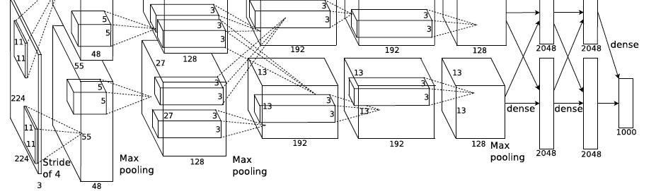
AlexNet
Similar framework to LeCun’98 but:
Bigger model (7 hidden layers, 650,000 units, 60,000,000 params)
More data (10⁶ vs. 10³ images)
GPU implementation (50x speedup over CPU)
Trained on two GPUs for a week
A. Krizhevsky, I. Sutskever, and G. Hinton, ImageNet Classification with Deep Convolutional Neural Networks, NIPS 2012
Notes:
Two-GPU architecture

Slide 22
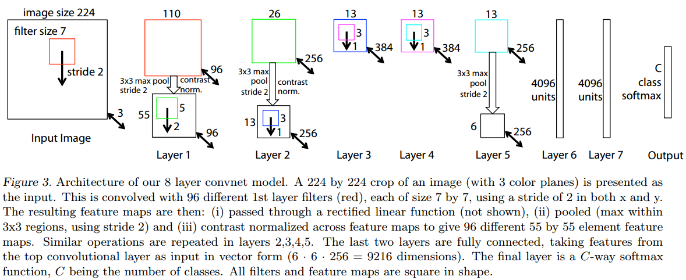
Refinement of AlexNet architecture
M. Zeiler and R. Fergus, Visualizing and Understanding Convolutional Networks, arXiv preprint, 2013

Slide 23
ZFNet refinements
Very similar architecture to AlexNet, except for a few minor modifications.
AlexNet trained on 15 million images, while ZF Net trained on only 1.3 million images.
Instead of using 11x11 sized filters in the first layer, ZF Net used filters of size 7x7 and a decreased stride value.
a smaller filter size in the first conv layer helps retain a lot of original pixel information in the input volume.

Slide 24
As the network grows, we see a rise in the number of filters used.
Used ReLUs for their activation functions, cross-entropy loss for the error function, and trained using batch stochastic gradient descent.
Trained on a GTX 580 GPU for twelve days.
Developed a visualization technique named Deconvolutional Network
helps to examine different feature activations and their relation to the input space.
Called “deconvnet” because it maps features to pixels (the opposite of what a convolutional layer does).

Slide 25
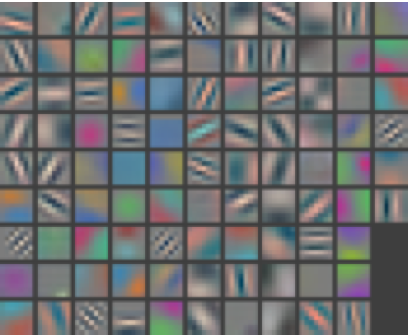
Layer 1 Filters
M. Zeiler and R. Fergus, Visualizing and Understanding Convolutional Networks, ECCV 2014 (Best Paper Award winner)

Slide 26
ImageNet Challenge
~14 million labeled images, 20k classes
Images gathered from Internet
Human labels via Amazon MTurk
Challenge: 1.2 million training images, 1000 classes
www.image-net.org/challenges/LSVRC/

Slide 27
ImageNet Challenge 2012-2014
Team | Year | Place | Error (top-5) | External data
SuperVision – Toronto (7 layers) | 2012 | - | 16.4% | no
SuperVision | 2012 | 1st | 15.3% | ImageNet 22k
Clarifai – NYU (7 layers) | 2013 | - | 11.7% | no
Clarifai | 2013 | 1st | 11.2% | ImageNet 22k
VGG – Oxford (16 layers) | 2014 | 2nd | 7.32% | no
GoogLeNet (19 layers) | 2014 | 1st | 6.67% | no
Human expert* |  |  | 5.1%
http://karpathy.github.io/2014/09/02/what-i-learned-from-competing-against-a-convnet-on-imagenet/
Notes:
Best non-convnet in 2012: 26.2%

Slide 28
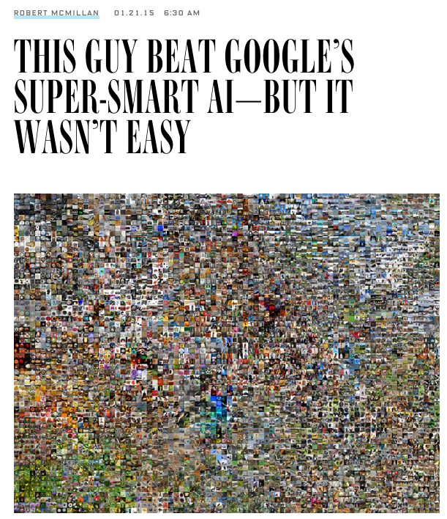

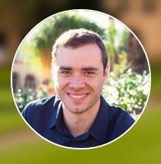


Slide 29
Humans and Computers
Stanford University researchers had just built the world’s most effective image-recognition software (2011)
50,000 images,
10 categories, such as “dogs,” “horses,” and “trucks.”
It was right about 80 percent
Karpathy wanted to compare his brain with their digital creation
He scored 94%
Since then, Google scored 93.4% on ImageNet; Karpathy now scored a measly 85% accuracy!
Previously, humans consistently beat machines; not quite so easily any more with CNN and its variants

Slide 30
ImageNet Challenge 2015
Team | Year | Place | Error (top-5) | External data
SuperVision – Toronto (7 layers) | 2012 | - | 16.4% | no
SuperVision | 2012 | 1st | 15.3% | ImageNet 22k
Clarifai – NYU (7 layers) | 2013 | - | 11.7% | no
Clarifai | 2013 | 1st | 11.2% | ImageNet 22k
VGG – Oxford (16 layers) | 2014 | 2nd | 7.32% | no
GoogLeNet (19 layers) | 2014 | 1st | 6.67% | no
CUImage | 2016 | 1st | % | no

Slide 31
Microsoft ResNet
https://adeshpande3.github.io/adeshpande3.github.io/The-9-Deep-Learning-Papers-You-Need-To-Know-About.htm
ResNet is a new 152 layer network architecture that set new records in classification, detection, and localization through one incredible architecture.

Slide 32
Deep learning packages
Caffe
pyTorch
Theano
TensorFlow
Matconvnet
…
http://deeplearning.net/software_links/

Slide 33
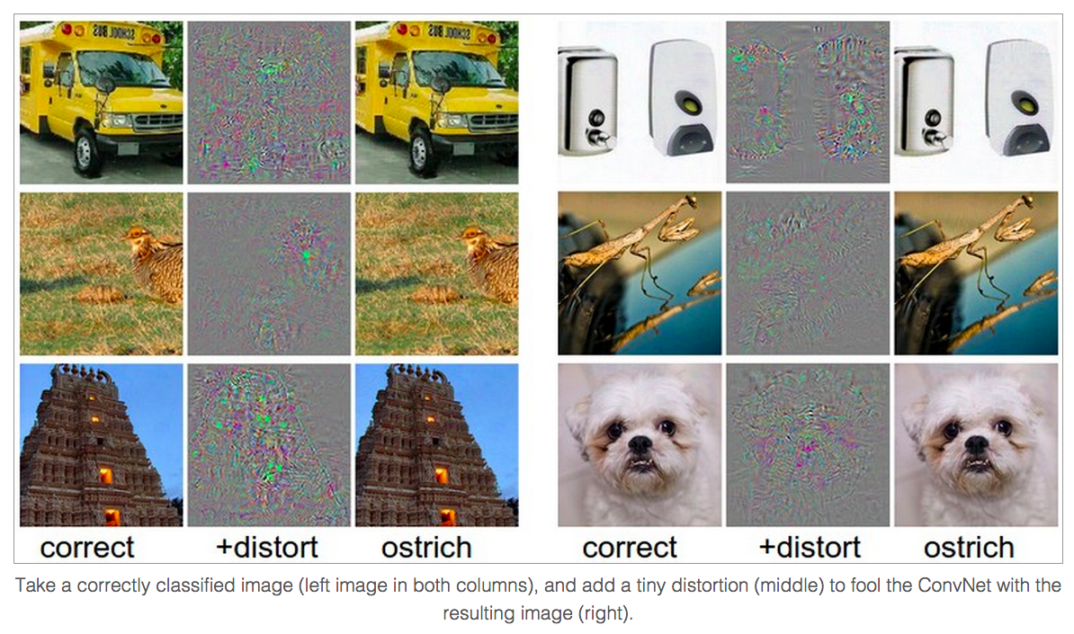
Breaking CNNs
http://arxiv.org/abs/1312.6199
http://karpathy.github.io/2015/03/30/breaking-convnets/

Slide 34
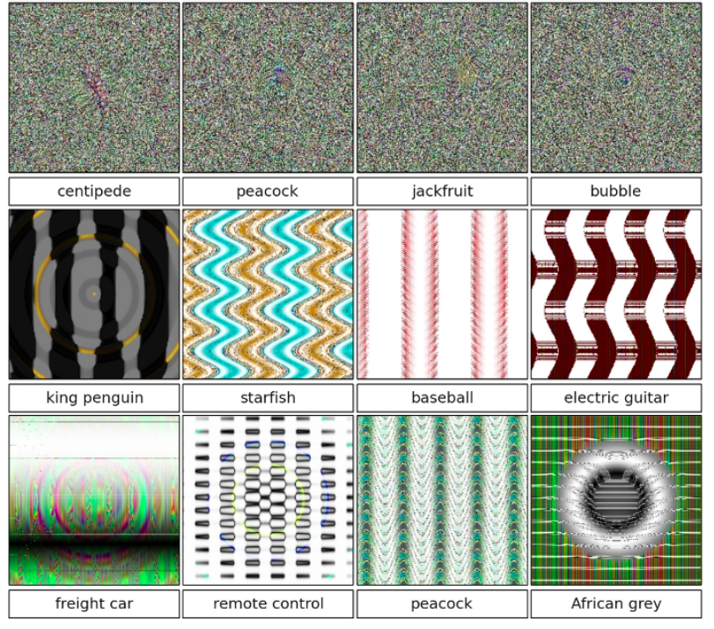
Breaking CNNs
http://arxiv.org/abs/1412.1897
http://karpathy.github.io/2015/03/30/breaking-convnets/

Slide 35
What is going on?
Recall gradient descent training: modify the weights to reduce classifier error
Adversarial examples: modify the image to increase classifier error
http://arxiv.org/abs/1412.6572
http://karpathy.github.io/2015/03/30/breaking-convnets/

Slide 36
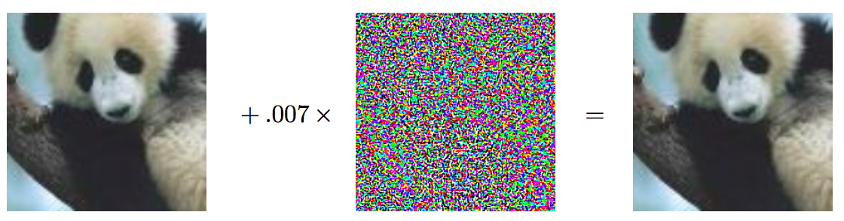
What is going on?
x
http://arxiv.org/abs/1412.6572
http://karpathy.github.io/2015/03/30/breaking-convnets/

Slide 37
Fooling a linear classifier
Perceptron weight update: add a small multiple of the example to the weight vector:
w ← w + α x
To fool a linear classifier, add a small multiple of the weight vector to the training example:
x ← x + α w

Slide 38
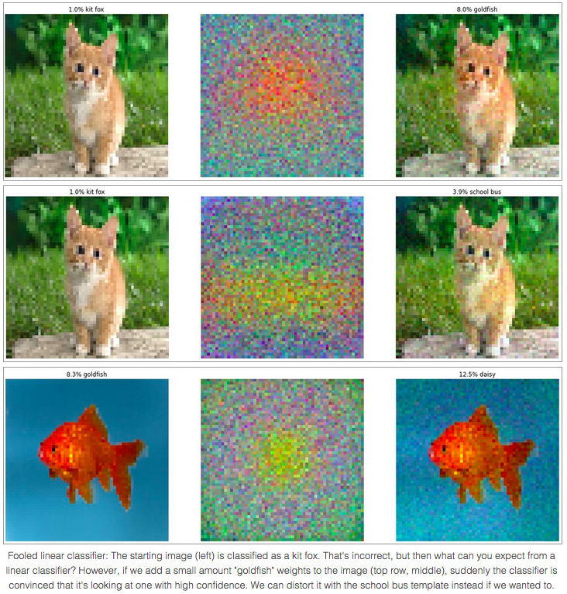
Fooling a linear classifier
http://karpathy.github.io/2015/03/30/breaking-convnets/

Slide 39
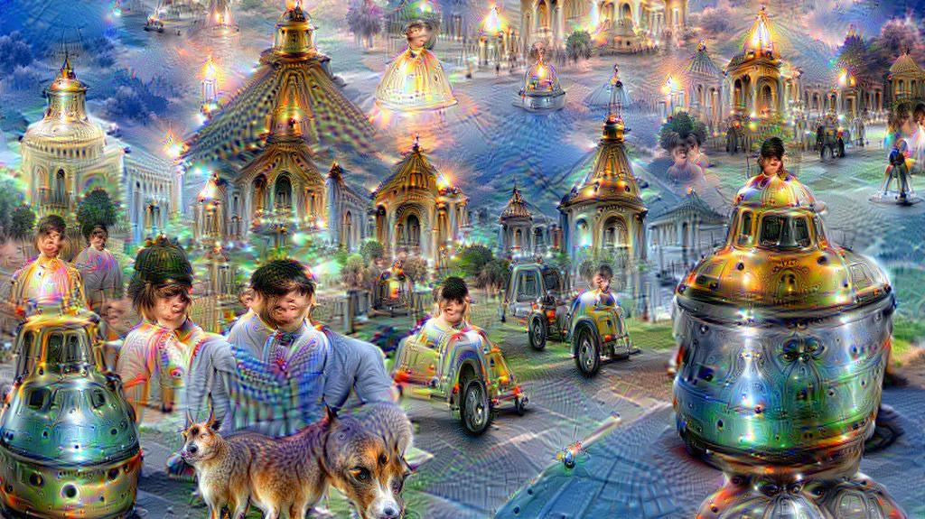
Google DeepDream
Modify the image to maximize activations of units in a given layer
https://github.com/google/deepdream/blob/master/dream.ipynb

Slide 40
DeepDream
DeepDream a CNN to enhance patterns in images to create a dream-like
The program creates images that produce desired activations in a trained deep network
The CNN run in reverse to adjust the original image slightly so that a given output neuron
(e.g. the one for faces or certain animals) yields a higher confidence score.
The optimization resembles Backprop,
but instead of adjusting the network weights, the weights are held fixed and the input is adjusted

Slide 41
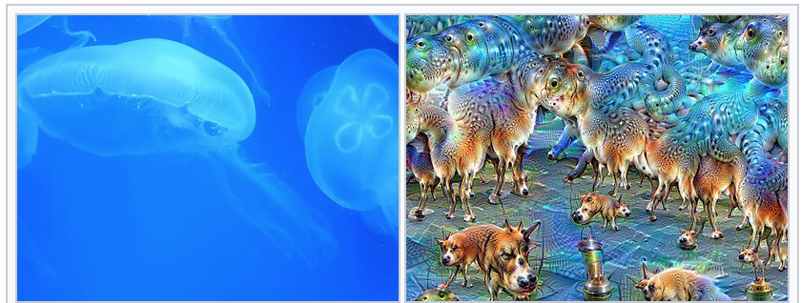
DeepDream cont’d
From Wikipedia: The same image before (left) and after (right) applying fifty iterations of DeepDream, the network having been trained to perceive dogs.

Slide 42
Next class
Hands-on neural networks homework
Readings for today:
Online deep learning tutorial from Stanford
http://cs231n.github.io/convolutional-networks/

Slide 43

Questions

